Slide 1
Presentation of mama’s bite
By Group 5

Slide 2
Members
Surinder Giri(1894148)
Deeksha Rani (1893173)
Satwinder Singh (1893207)
Gurjeet Singh (1892849)

Slide 3
Content
Introduction of mama’s bites
Objective
Targeted audience
Use case diagram
UML Design
Design
Challenges while implementing and their solution
Benefits of buyers
Benefits of sellers
Money making
Wire Frame

Slide 4
Introduction of mama’s bites
The main purpose of this application is to provide the homemade food to the customers through online service.
The application provides the opportunities to the unemployed people who want to start their business from home.
Moreover, people who are missing their cultural food as living in foreign countries for study purposes and other reasons
Additionally, there is a third party interface which provide connection between buyers and sellers.
A third party can earn money through online transaction and subscription plans in an efficient manner.

Slide 5
Objective
By doing the research on home sickness we concluded that people face this issue because they missing the taste of their home food.
Our application enable the user to access regionally cooked food.
Although there are so many restaurants and hotels which provide the cultural food but there is a lack of feeling of home food.

Slide 6
USE CASE DIAGRAM

Slide 7
UML Class Diagram

Slide 8
Design UI & UX

Slide 9
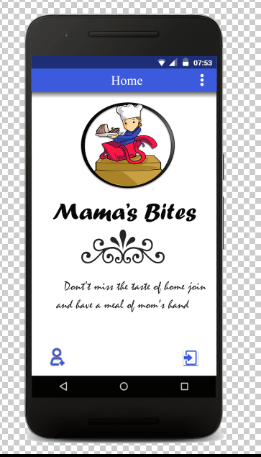
Home Page
There are two buttons show in the bottom side of the home page. On the left side there is a sign up page categories
On the right side, there is a button of login directly if the customer is already register with us.

Slide 10
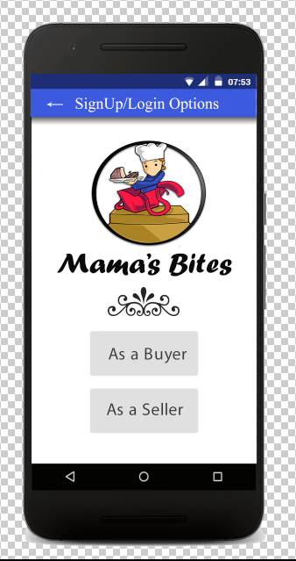
Sign up and Login Categories
This page is for choosing the option between two categories.
Two options are available in this page.
In the first option a user can select the profile as a buyer and second option is for seller who wants to do business their product on this application.

Slide 11
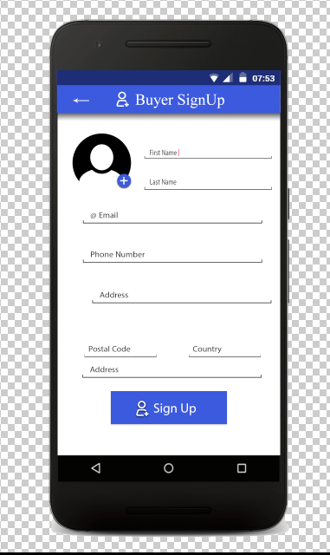
Buyer Sign up
This page is for buyer’s sign up. A user can fill up their information in the form for login in application.
A client have to enter their first name, last name and his/her email id.
Moreover, a user can also enter his phone number so that buyer can directly communicate with sellers and address for the deliveries.

Slide 12
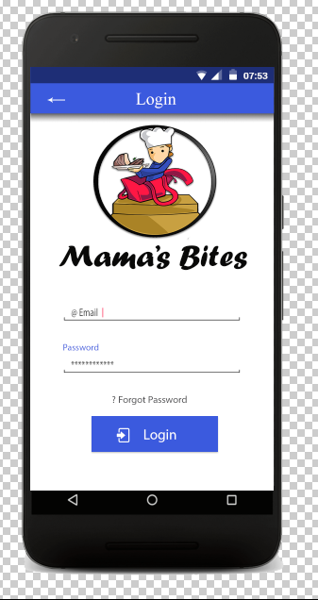
Buyer Login
A user who are already registered
Can select their categories and access application directly through registered email and password and they can get into the application.

Slide 13
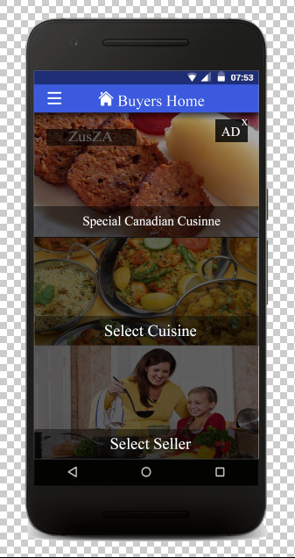
Buyers Home
After sign up and login a user can access the home page which includes special Canadian cuisines, select cuisine and select seller.
Moreover, there is a menu button on the top left where a user move to another page.

Slide 14
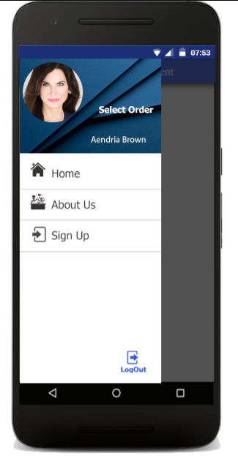
Menu bar of buyer
This is a design of menu bar its proper functionality represented in wire frame and prototype.

Slide 15
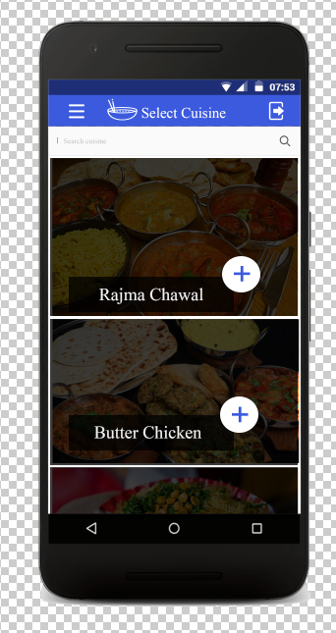
Select Cuisine
In this page, a user can select the cuisine according their taste.
On the top side, there is a search button, where a user can search out their cuisine.
Along with this, there plus sign on every cuisine which is used to get the detail of the particular cuisine.

Slide 16
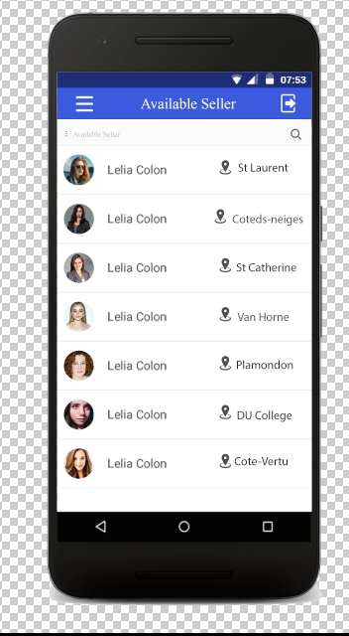
Available Seller
In this page, description of all available sellers with their location and by clicking on card of particular seller there will another page display.

Slide 17
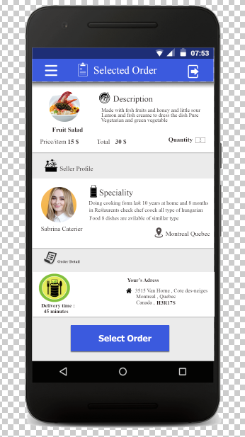
Selected Order
After selection of dish and seller there will be a next page which describe the whole selected order.
Moreover, in this page, there is a detail of dish which includes quantity and price.
Along with this , detail of the seller with their specialty.
At last, there is a estimated arrival time of food delivery .
After selection buyer can make order by pressing the select order button.

Slide 18
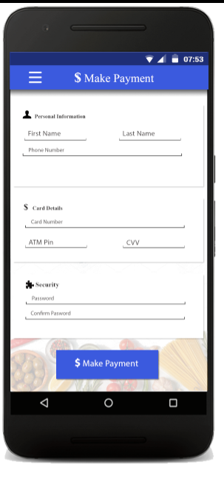
Make Payment
After order, now its time for the payment of the dish.
A user can enter his name and phone with his credit or debit detail to buy the dish easily.
There is no longer process for the payment.
Additionally, a user can enter the security password for the safe payment process.

Slide 19
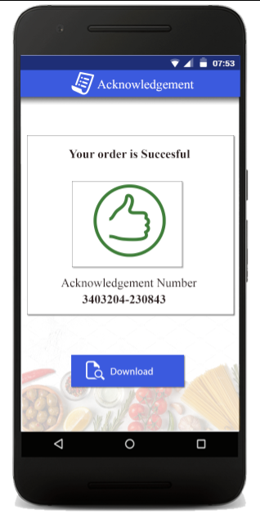
Acknowledgement
After completing the payment process, a user will get the acknowledgement of their order with specific number which is shown in the picture.
A user can also download or print their acknowledgement in an appropriate manner by clicking on download button.

Slide 20
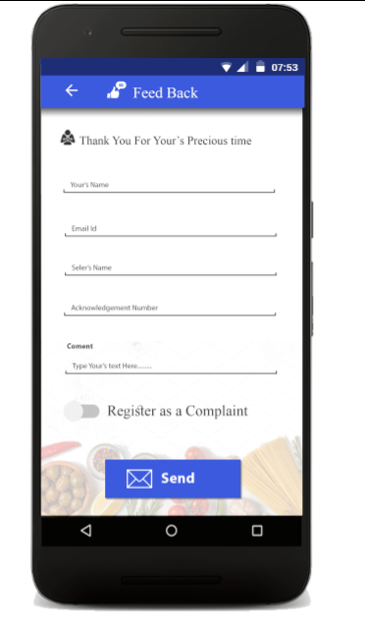
Feedback
Feedback plays an imperative role for the improvement.
At last page, there is a feedback page for the buyer where a user can enter their experience to deal with this application
If user is not satisfied with deal, so they can click the option at the bottom side to register the information as a complaint.
At the end , there is a sending button at bottom for user can send his feedback to administrator.

Slide 21
Seller

Slide 22
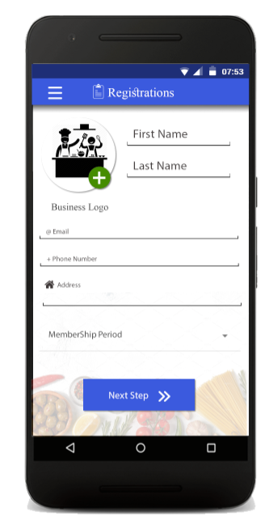
Seller Registration
This is a registration form for the seller.
A seller can upload their business logo with all his personal information such as name, email and phone number.
There is a also membership period option, which is to join the membership of the application.(mandatory field)

Slide 23
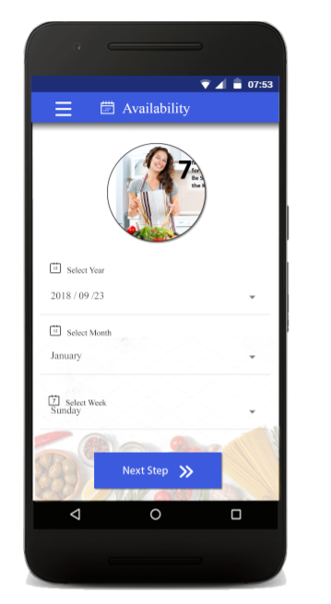
Seller availability
In this page, a seller can provide the information related to their availability to the buyer.

Slide 24
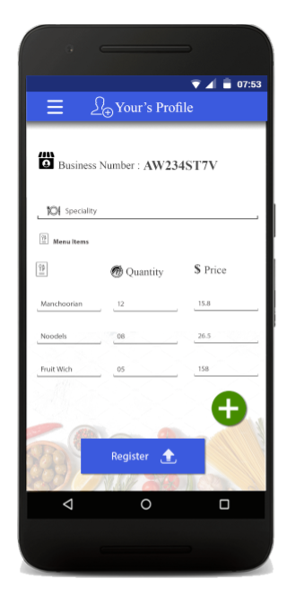
Seller profile
In the profile page, there is a business number shows on the top, which is automatically generated by application to the seller.
Following this, there is specialty option where a seller can define his experienced.
Moreover, there table chart where a seller can edit his information such as quantity of item and his price for the dish.

Slide 25
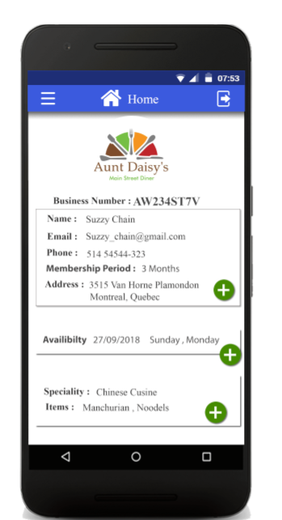
Seller home
This is the home page of the seller, which illustrates the whole profile of the seller with his availability.
Along with this, there is a option of specialty, which demonstrates the type of cuisine.
At last, there is also a items field where seller can show their recipes and items.

Slide 26
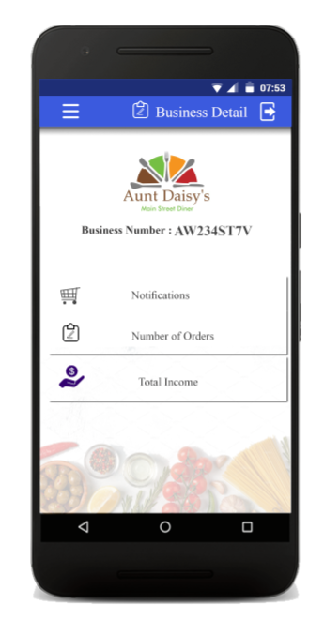
Business detail
This is a business detail page, where a user can get their notification, number of orders and total income with business number.

Slide 27
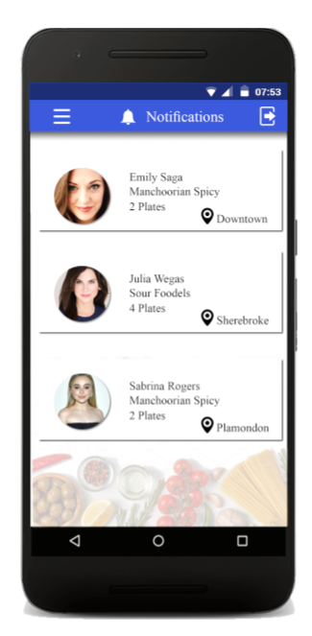
Seller notification
A seller can see the buyer’s order with their name, contact and location.

Slide 28
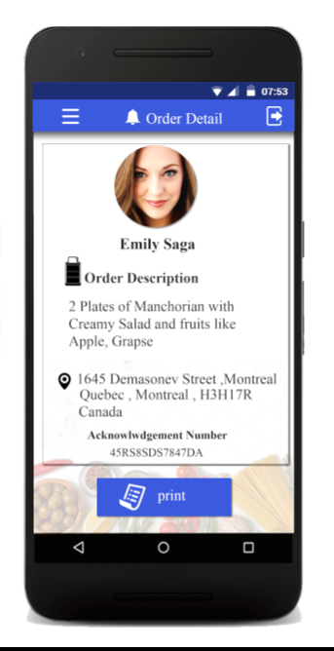
Seller Order detail
This is a order detail page where a user can see whole profile of the buyer.
A seller can also watch the location of the buyer , which helps to user to deliver.
Additionally, a seller can also see the acknowledgement number.
At last a seller can print the order detail for the safety of the order.

Slide 29
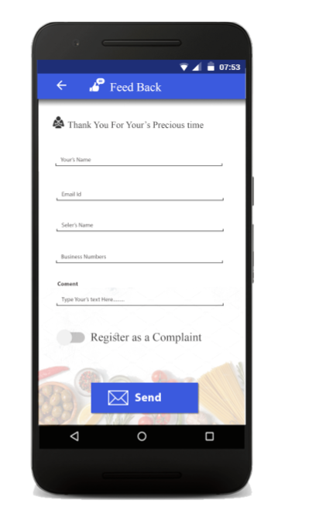
Feedback
This is a feedback form which help a seller to enter the comment and suggestions so they can send their experience by using this application in an appropriate manner.

Slide 30
Wire Frame

Slide 31
Challenges while implementing and their solutions
Problem : Difficulties to find out the idea to build the application because of less competition.
Solution :To solve this, we searched out for the competitor in the market and we find out one application named as tiffin bites. The main functionality of this application is to provide home delivery to different chain of restaurants in north Manchester. And our some part of work resembles with this application.
Problem : This application is accessible worldwide, so different nation's people cannot understand the application format as well as the food which provided by the sellers.
Solution : We use international language which is known as simple english which understandable for everyone and we use simple icons to provide user friendly interface.

Slide 32
Benefits of buyers
User can download the app in their mobile phone and it is free of cost.
Buyers can taste different culture cuisine.
Client can search any food according to their taste.
Moreover, there is a feedback form for the user to provide their experience.
They can also use the complain box if there is any issue related to services.
A user can directly communicate with any seller through the telephone system.
Additionally, a user can select items from menus according to their
quantity.
After buying any food, a user get acknowledge through their email id.
A user can also see the location on map which is provided by the user.
They can also check it out the timing of their order to deliver at their
place.

Slide 33
Benefits of seller
Firstly a seller can edit their profile with their different recipes
in this application.
Secondly, there is order management system for the sellers so
they can see the orders and their order.
Thirdly, a seller can get some benefits from membership card
which is provided by the application owner.
This app is prominent platform for seller to startup their
business online and earn money easily and efficiently.
Seller who wants to work from home and have skills , they can
gain name and fame through their culinary skills by promoting
their recipes on this application.

Slide 34
Money Making
From the flow of transactions (Payment Gate Ways).
From Seller Membership (Registration of Buyer is Free).
Data collected for the choice of users.(By Selling Data).
Google Advertisements.

Slide 35
Updates for the next version
Missing functions :-
Buyer cannot be edit his personal information after sign up.
Buyer cannot cancel or change the order once it was placed.
Up gradation needed in Functionality of available seller.
Solutions:- to overcome these problems,
We will provide additional button to edit the personal file after signup .
We will provide additional button for change the order and cancel the order in the next version.
We will fix it soon the functionality of available seller.

